Slide 1
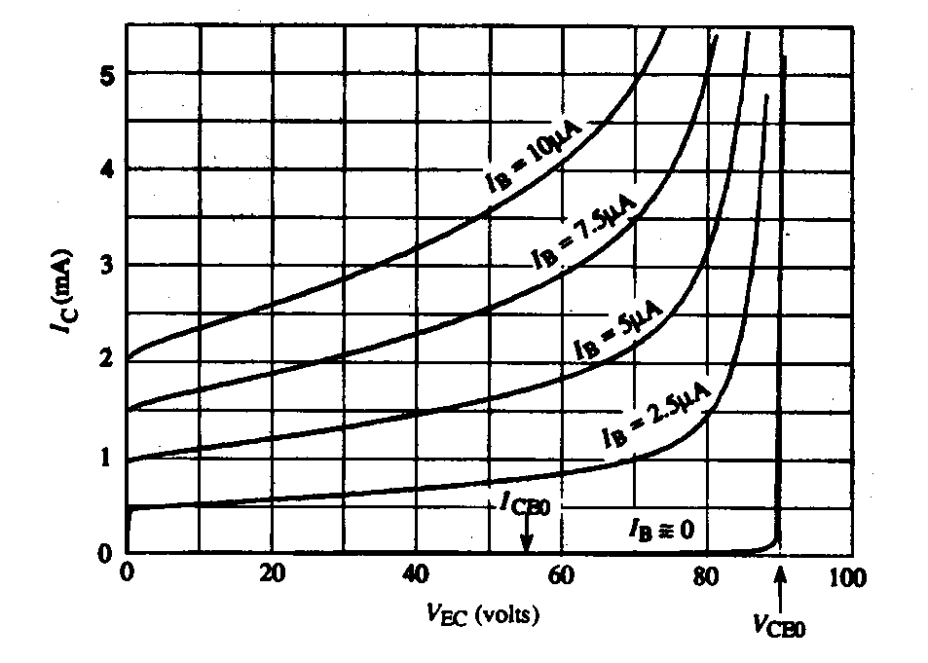
Lecture #25
OUTLINE
BJT: Deviations from the Ideal
  Base-width modulation, Early voltage
  Punch-through
  Non-ideal effects at low |V_{EB}|, high |V_{EB}|
Gummel plot
Reading: Chapter 11.2
Measured BJT
Common-Emitter
Output Characteristics:

Slide 2
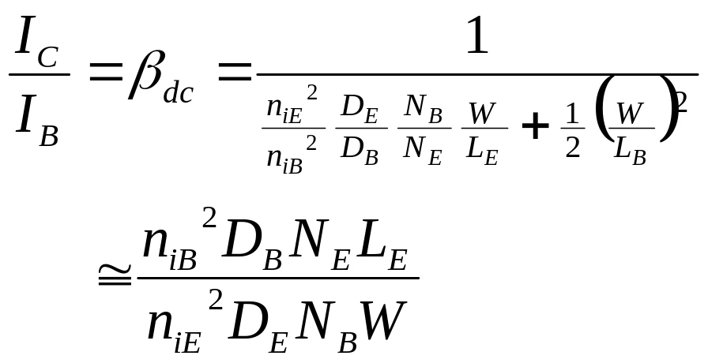

Base-Width Modulation
Common-Emitter Configuration, Active Mode Operation
W
I_{E}
P+
N
P
I_{C}
+
−
V_{EB}
Δp_{B}(x)
I_{C}
(V_{CB}=0)
x
V_{EC}
0
W(V_{BC})

Slide 3
The base-width modulation effect is reduced if we
(a) increase the base width, W, or
(b) increase the base dopant concentration, N_{B}, or
(c) decrease the collector dopant concentration, N_{C} .
Which of the above is the most acceptable action?

Slide 4
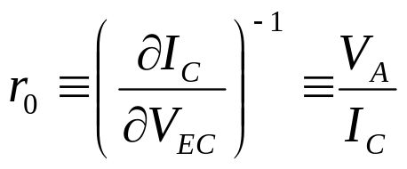
Early Voltage, V_{A}
Output resistance:
A large V_{A} (i.e. a large r_{o} ) is desirable
I_{C}
I_{B3}
I_{B2}
I_{B1}
V_{A}
0
V_{EC}

Slide 5
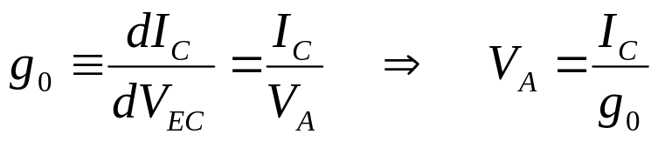
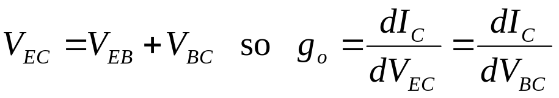
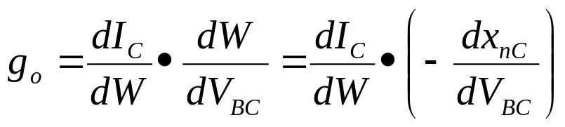
Derivation of Formula for V_{A}
Output conductance:
for fixed V_{EB}
where x_{nC} is the width of the
collector-junction depletion region
on the base side
x_{nC}
P+
N
P

Slide 6
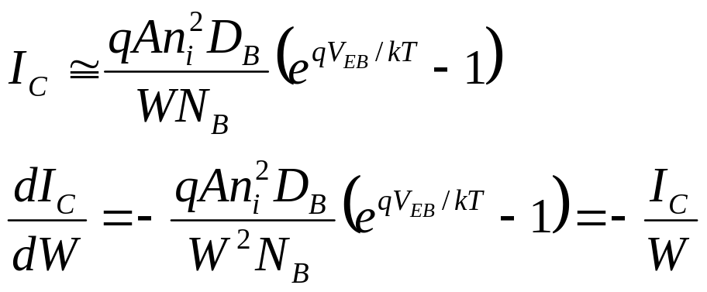
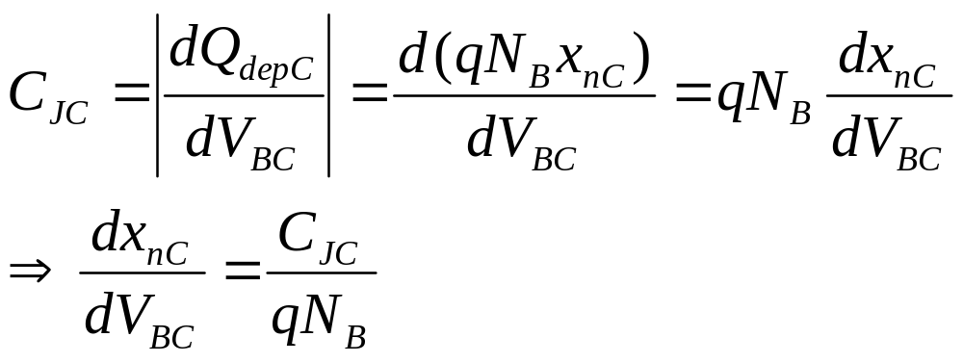
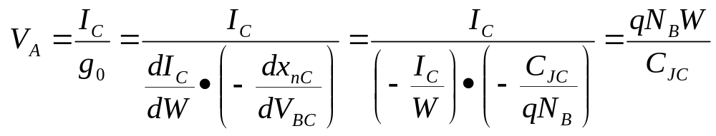

Slide 7
BJT Breakdown Mechanisms
In the common-emitter configuration, for high output voltage V_{CE}, the output current I_{C} will increase rapidly due to one of two mechanisms:
  punch-through
  avalanche

Slide 8
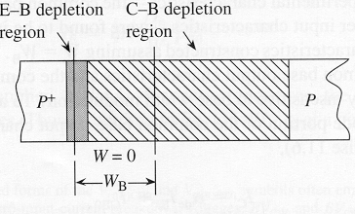
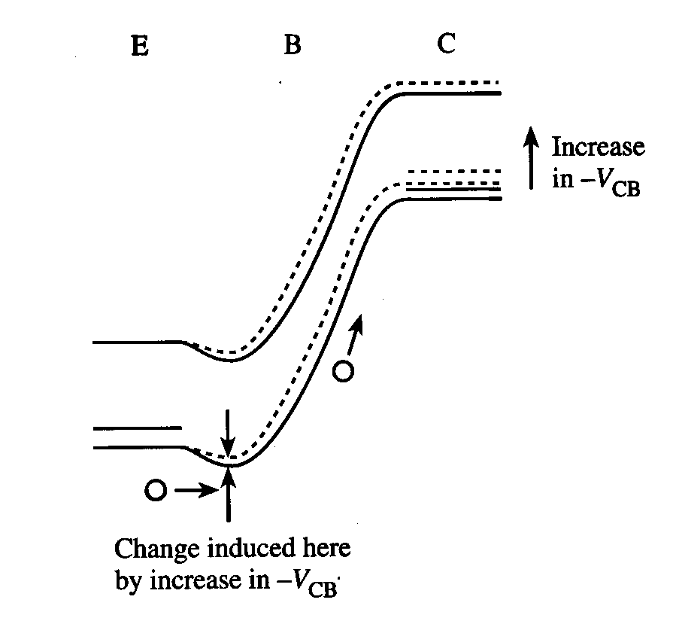
Punch-Through
E-B and E-B depletion regions in the
base touch, so that W = 0
As |V_{CB}| increases, the potential barrier
to hole injection decreases and therefore
I_{C} increases

Slide 9
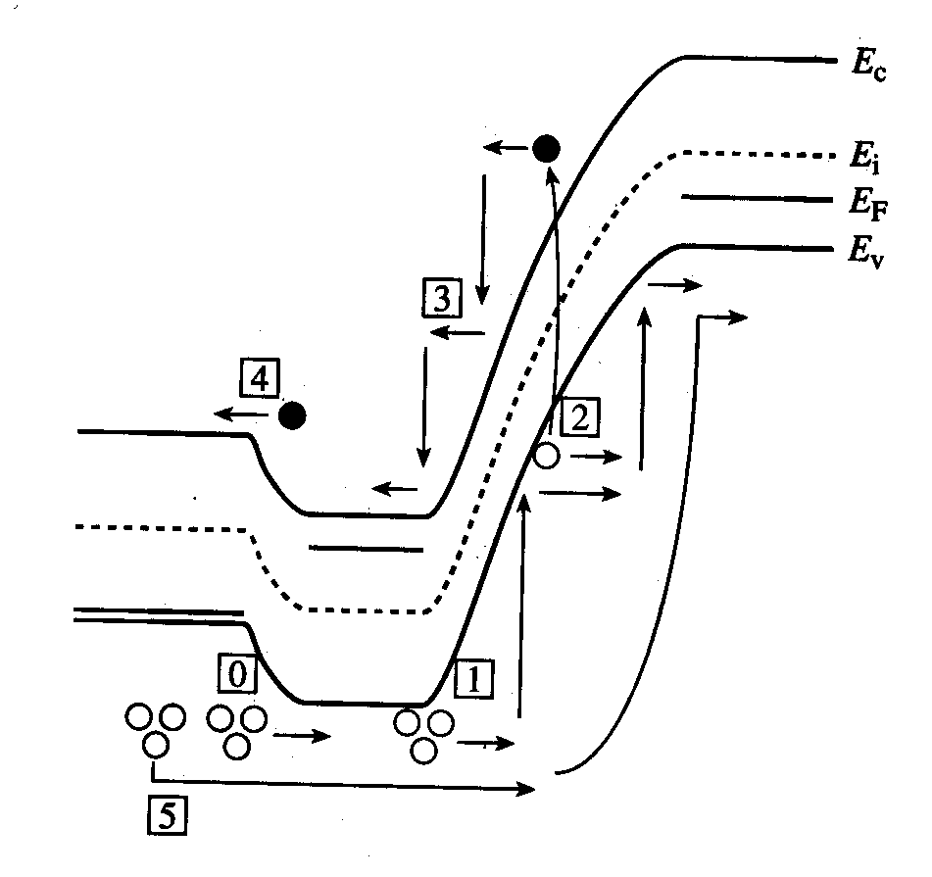
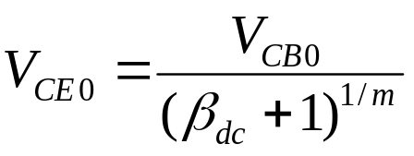

Avalanche Multiplication
Holes are injected into the base [0], then collected by the B-C junction
  Some holes in the B-C depletion region have enough energy to generate EHP [1]
The generated electrons are swept into the base [3], then injected into the emitter [4]
  Each injected electron results in the injection of I_{Ep}/I_{En} holes from the emitter into the base [0]
PNP BJT:
For each EHP created in the C-B depletion region by impact ionization,
(I_{Ep}/I_{En})+1 > β_{dc} additional holes flow into the collector
i.e. carrier multiplication in C-B depletion region is internally amplified
where V_{CB0} = reverse breakdown voltage of the C-B junction

Slide 10
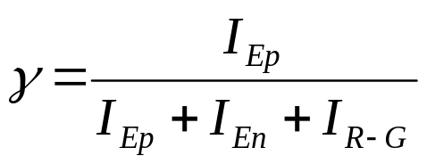
Non-Ideal Effects at Low V_{EB}
In the ideal transistor analysis, thermal R-G currents in the emitter and collector junctions were neglected.
Under active-mode operation with small V_{EB}, the thermal recombination current is likely to be a dominant component of the base current
  low emitter efficiency, hence lower gain
  This limits the application of the BJT for amplification
  at low voltages.

Slide 11
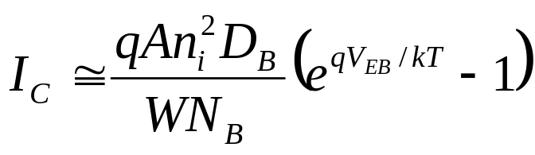
Non-Ideal Effects at High V_{EB}
Decrease in β_{F} at high I_{C} is caused by:
  high-level injection
  series resistance
  current crowding

Slide 12
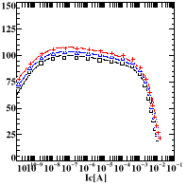
Gummel Plot and β_{dc} vs. I_{C}
10
-2
high level
injection in base
10
-4
I
C
β_{dc}
10
-6
I
B
β
From top to bottom:
V_{BC} = 2V, 1V, 0V
10
-8
10
-10
excess base current due to R-G
in depletion region
10
-12
0.2
0.4
0.6
0.8
1.0
1.2
V
BE

Slide 13
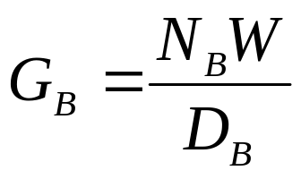
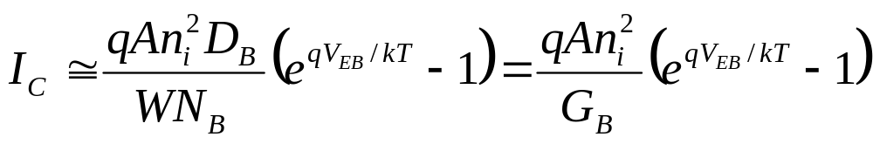
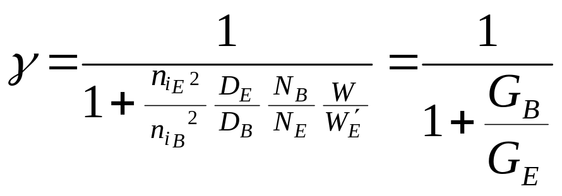
Gummel Numbers
For a uniformly doped base with negligible band-gap narrowing, the base Gummel number is
(= total integrated “dose” (#/cm²) of majority carriers in the base, divided by D_{B})
Emitter efficiency
G_{E} is the emitter Gummel number

Slide 14
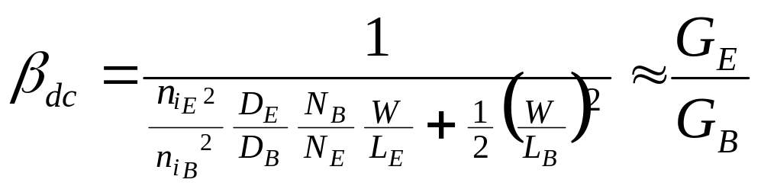
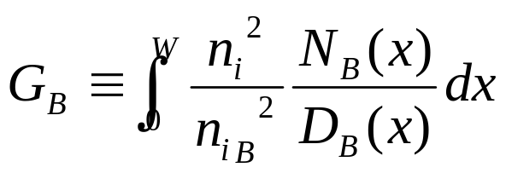

Notice that
In real BJTs, N_{B} and N_{E} are not uniform, i.e. they are functions of x
The more general formulas for the Gummel numbers are

Slide 15
Summary: BJT Performance Requirements
High gain (β_{dc} >> 1)
  One-sided emitter junction, so emitter efficiency γ ≈ 1
    Emitter doped much more heavily than base (N_{E} >> N_{B})
  Narrow base, so base transport factor α_{T} ≈ 1
    Quasi-neutral base width << minority-carrier diffusion length (W << L_{B})
I_{C} determined only by I_{B} (I_{C} ≠ function of V_{CE},V_{CB})
  One-sided collector junction, so quasi-neutral base width W does not change drastically with changes in V_{CE} (V_{CB})
    Based doped more heavily than collector (N_{B} > N_{C})
        (W = W_{B} – x_{nEB} – x_{nCB} for PNP BJT)

Slide 16
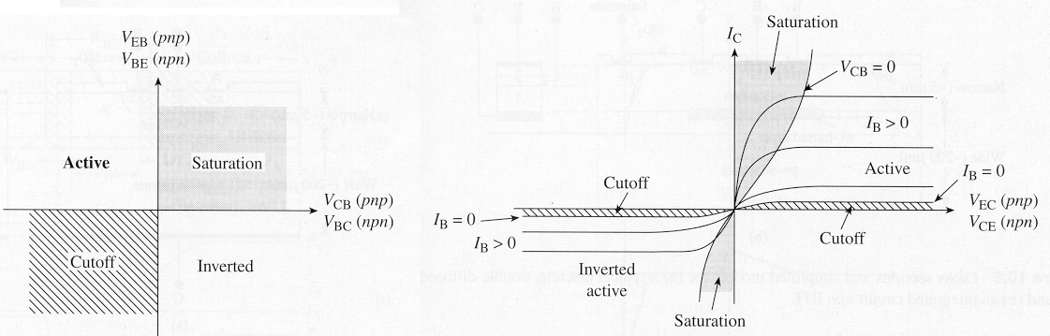
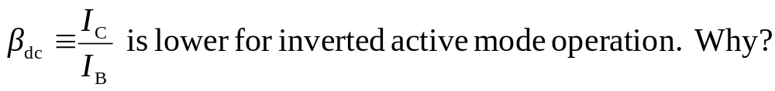
Review: Modes of Operation
Common-emitter output characteristics
(I_{C} vs. V_{CE})

